Slide 1
Flow Control Instructions
1

Slide 2
Overview
For assembly language-programs to carry out useful tasks, there must be a way to make decisions and repeat sections of code.
  jump
  loop
The jump and loop instructions transfer control to another part of the program. this transfer can be unconditional or can depend on a particular combination of status flag settings.

Slide 3
Transfer of Control
Flow control instructions are used to control the flow of a program.
Flow control instructions can be of two types: unconditional and conditional.

Slide 4
Types of Jump Instructions
4
Unconditional Jump
Signed jump
Jump Instruction
Unsigned jump
Conditional Jump
Single Flag jump

Slide 5
Example
Display the entire IBM character set
TITLE PGM6_1.ASM
.MODEL SMALL
.STACK 100H
.CODE
MAIN PROC
MOV AH,2 ; display char function.
MOV CX,256 ; no. of chars to display.
MOV DL,0 ;DL has the ASCII code of NULL char.
PRINT_LOOP:
INT 21h ;DISPLAY A CHAR.
INC DL ; INCREMENT ASCII CODE.
DEC CX ; DECREMENT COUNTER.
JNZ PRINT_LOOP ; KEEP GOING IF CX#0
; DOS exit
MOV AH,4CH
INT 21h
MAIN ENDP
END MAIN

Slide 6
Output of Program

Slide 7
Conditional Jumps
Conditional Jumps
  Conditional Jumps have the syntax:
    Jxxx destination_label
  The destination-label, a symbolic name, refers to the instruction that follows it
  If the condition for the jump is true, the next instruction to be executed is specified in the destination label
  If the condition for the jump is false, the next sequential instruction in your code will be executed
  The structure of the machine code requires that the destination label must precede the jump instruction by no more than 126 bytes and cannot follow it by more than 127 bytes. ((We will see a way to get around this restriction later !!)

Slide 8
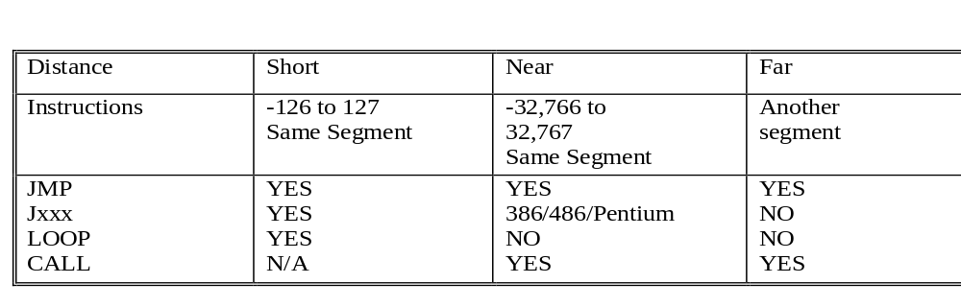
A note on addresses in PC Assembler Language
There are three types of addresses in PC Assembler Language
  short, near, and far
A short address is reached by an offset and is limited to a distance of -126 to 127 bytes.
A near address is reached by an offset and is limited to a distance of -32,766 to 32,767 bytes within the same segment.
A far address is in another segment and is reached by a segment address and offset.

Slide 9
How the CPU Implements a Conditional Jump
The CPU checks FLAGS register
If the proper combination of status FLAGS are set, the CPU adjusts the IP to point to the destination label
There are three categories of conditional jumps
  Signed jumps
  Unsigned jumps
  Single flag jumps

Slide 10
Conditional Jump Instructions
Conditional jump instructions are the basic tools for creating selective structures like the IF..ENDIF statement and repetitive structures like loops.
A conditional jump tests one or more flags in the flags register
the target address must be within a range of -128 to +127 from the IP

Slide 11
Current
instruction
IP
001B 83 C0 64 ADD AX, 100
001E EB 06 JNC L01
0020 83 C0 0A L00: ADD AX, 10
0023 83 C0 05 ADD AX, 5
0026 8B D8 L01: MOV BX, AX
If the condition is false, it will jump to the next line.
If the condition is True, it will jump to the next line.

Slide 12
Conditional Jump Example
7
Instruction 1
Instruction 2
Instruction 3
…………….
…………….
; general instruction
; general instruction
; general instruction
; general instructions continues
; general instructions continues
; Compare instruction
; Conditional Jump
CMP AX, BX
Jxxx L1
Instruction 7
Instruction 8
L1: MOV AX, 0
……………
……………
……………..
If the condition is false, it will jump to the next line.
If condition is true, it will
jump to “L1: MOV Ax, 0”

Slide 13
How CPU implements a Conditional Jump
8
To implement a conditional jump, the CPU looks at the Flag registers.
You already know that flag register reflects the result of the last thing the processor did. (In chapter 5)
If the conditions for the jump (expressed as a combination of status flag settings) are true; the CPU adjusts the IP to point to the destination label, so that the instruction at this label will be done next.
If the jump condition is false, then IP is not altered; this means the next instruction in line will be done.

Slide 14
Conditional jump instructions
If the flag settings match the instruction, control transfers to the target location
If the match fails, the CPU ignores the conditional jump and execution continues with the next instruction.

Slide 15
Conditional jump instructions
Conditional jump instructions are divided into three main types:
Single Flag Based Jump Instructions
Unsigned Conditional Jump Instructions
Signed Conditional Jump Instructions

Slide 16
Conditional jump
In assembly language, when two numbers are compared, it is imperative to know that:
A signed number can be Greater, Less, or Equal to another signed number.
An unsigned number can be Above, Below, or Equal to another unsigned number.

Slide 17
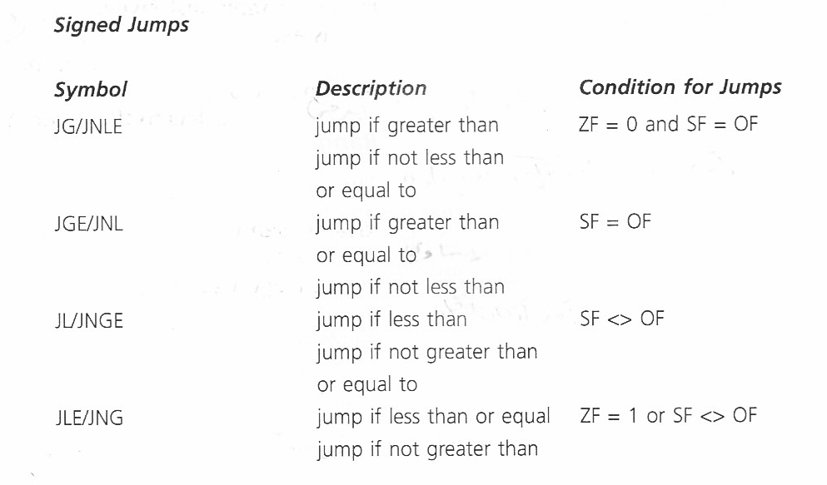
Conditional jump instructions

Slide 18
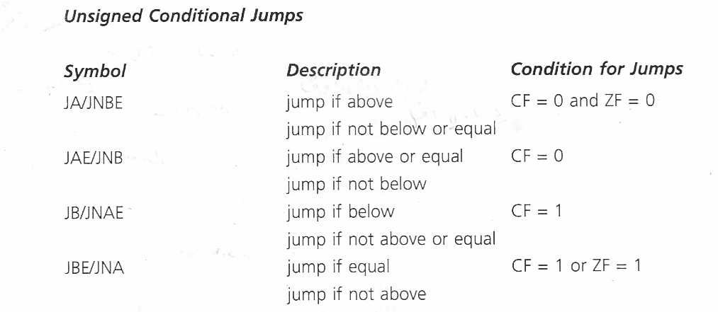
Conditional jump instructions

Slide 19
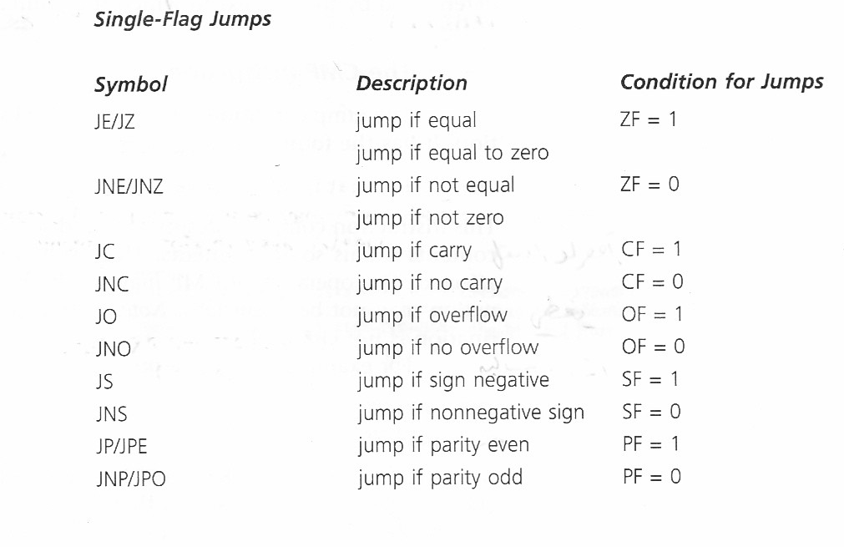
Conditional jump instructions

Slide 20
Conditional jump instructions
Most of the time, a conditional jump is executed after a CMP instruction.
The CMP instruction sets the flags so that test can be carried out for less than, greater than, equality, etc

Slide 21

Example
JG/JNLE ZF=0 & SF = OF
JGE/JNL SF=OF
JL/JNGE SF<>OF
JLE/JNG ZF=1 or SF <> OF

Slide 22
CMP Instruction
The CMP instruction has the following format:
CMP destination, source
The destination can be a register or memory operand
The source can be a register, memory operand, or an immediate operand
At most one of the operands may reside in memory.

Slide 23
CMP Instruction
The compare instruction (CMP) compares destination and source by performing: destination – source; the result is not stored
Unlike the SUB instruction the destination operand is not affected
The values of the status flags are set according to the result of the subtraction
The flags can be tested by a subsequent conditional jump instruction

Slide 24
CMP Instruction
CMP instruction EXAMPLE
CMP BX, CX ;Compare BX to CX
JNE Skip ;If BX <> CX skip
INC AX ;AX = AX + 1
Skip :

Slide 25
CMP Instruction
CMP AX,BX
JG BELOW
Where AX = 7FFFh, and BX = 0001.
7FFF – 0001= 7FFEh ZF=SF=OF=0
Condition is satisfied, control transfers to BELOW

Slide 26
Signed versus Unsigned jump
When comparing two numbers it is necessary to know whether these numbers are representing signed or unsigned numbers in order to establish a relationship between them.

Slide 27
Signed versus Unsigned jump
AL=FF and BL=01
CMP AL, BL
unsigned numbers :AL=255 and BL=1 and hence AL is greater than BL.
signed numbers: AL=-1 and BL=1 and hence BL is greater than AL.
we need conditional jump instructions for unsigned number comparison and conditional jump instructions for signed number comparison.

Slide 28
Signed versus Unsigned jump
AX= 7FFFh, BX=8000h
CMP AX,BX
JA BELOW
unsigned conditional jump the program does not jump to BELOW

Slide 29
CHARACTERS
With standard ASCII character set, either signed or unsigned jumps may be used.
With extended ASCII characters unsigned jumps should be used.

Slide 30
Example
Suppose AX and BX contain signed numbers. Write some code to put the biggest one in CX
MOV CX,AX ;put AX in CX
CMP BX,CX ;is BX bigger?
JLE NEXT ;no, go on
MOV CX,BX ;yes, put BX in CX
NEXT:

Slide 31
Unconditional Jump Instruction: JMP
The JMP instruction is the only unconditional flow control instruction
It unconditionally transfers control to another point in the program
The location to be transferred to is known as the target address

Slide 32
Jump Instruction
Syntax:
JMP destination
Destination is a label in the same segment as the JMP.
JMP can be used to get around the range restriction of a conditional jump

Slide 33
Jump Instruction
We want to implement the following loop:
TOP:
;body of the loop
DEC CX ;decrement counter
JNZ TOP ;keep looping if CX>0
MOV AX,BX
If the loop body contains so many instructions that label TOP is out of the range of JNZ we can do this:
TOP:
;body of the loop
DEC CX ;decrement counter
JNZ BOTTOM ;keep looping if CX>0
JMP EXIT
BOTTOM:
JMP TOP
EXIT:
MOV AX,BX

